Slide 1
YOLO Object Detection
Presented by: Hassan Khadra
Instructor: Elio Hanna

Slide 2
Table of contents
01
02
03
04
05
06
Project Overview
Data Preparation
Model Training
Inference
Docker
Reference

Slide 3
Let’s start!

Slide 4
01
Overview

Slide 5
Project Overview
This project implements an object detection system for industrial environments.
PART 1: DATA PREPERATION & VISUALIZATION
PyTorch DataLoader
Albumentations
PART 2: MODEL TRAINING & EVALUATION
TensorBoard
PART 3: MODEL DEPLOYMENT & INFERENCE
Netron
FastAPI

Slide 6
02
Part 1: Data Preparation

Slide 7
Data Preparation
Load the dataset using PyTorch DataLoader.
Visualize some of the labeled images.
Augment the dataset using Albumentations.
Split the training dataset into train and validation sets.

Slide 8
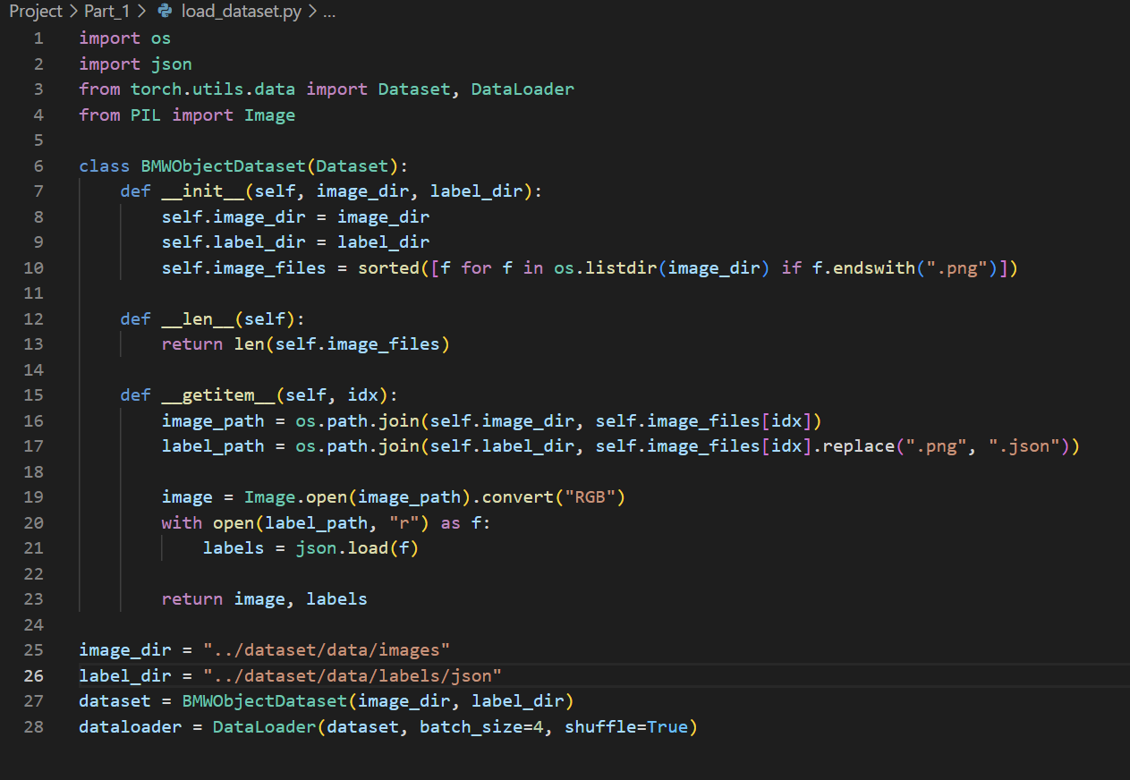
Data Preparation: Load Dataset
We use:
Json
Dataset
DataLoader
PIL

Slide 9
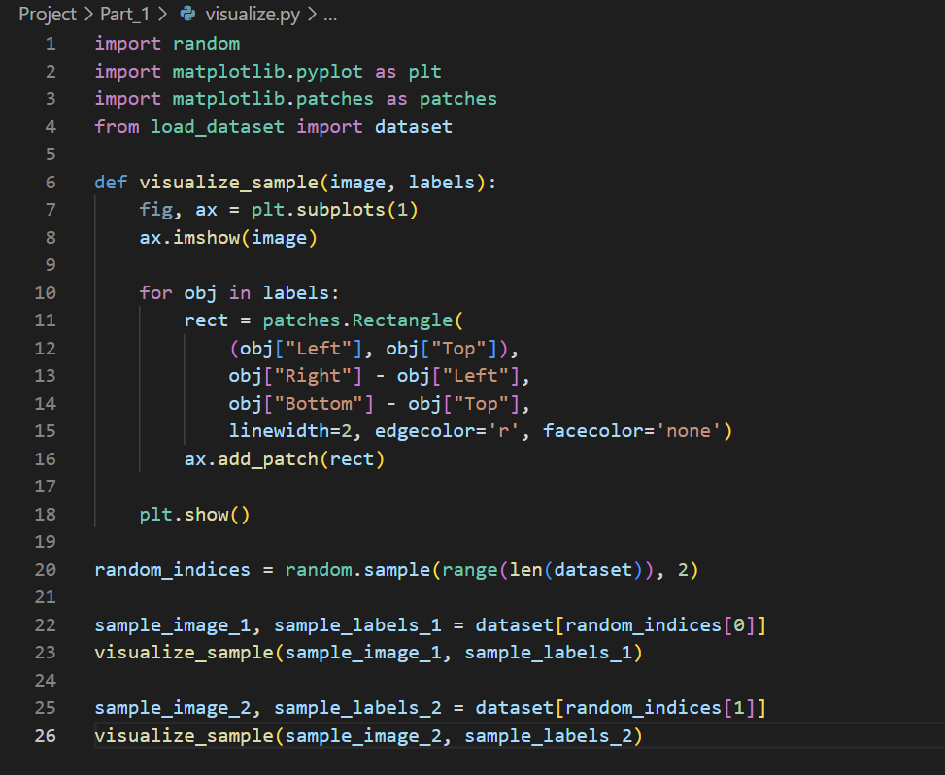
Data Preparation: Visualization
We use:
Matplotlib
Our previous loader

Slide 10
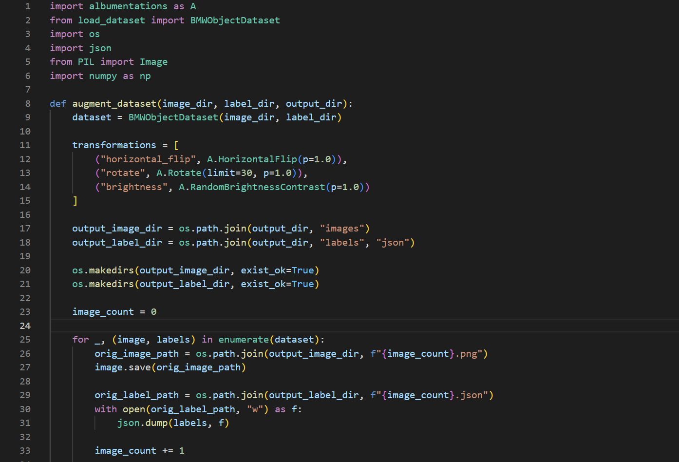
Data Preparation: Augmentation

Slide 11
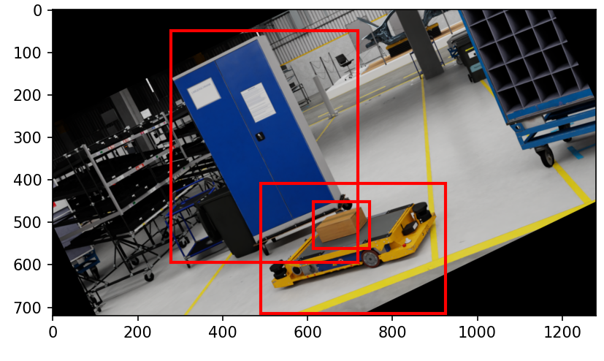
Data Preparation: Augmentation

Slide 12
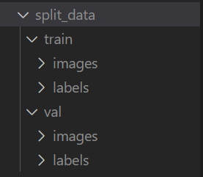
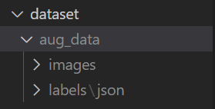
Data Preparation: Split Dataset

Slide 13
03
Model Training

Slide 14
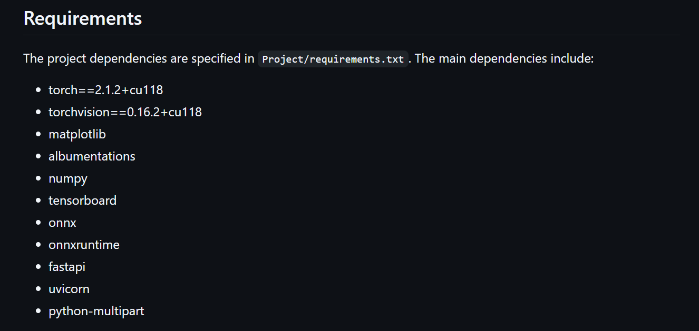
Requirements for the project

Slide 15
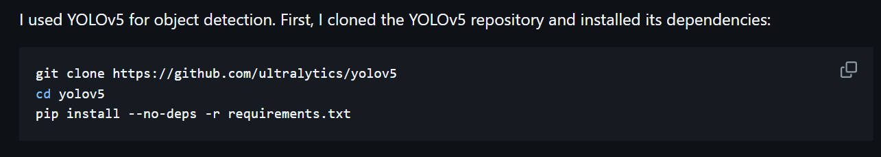
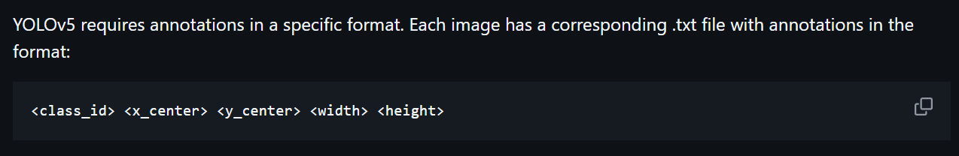
Model Training

Slide 16
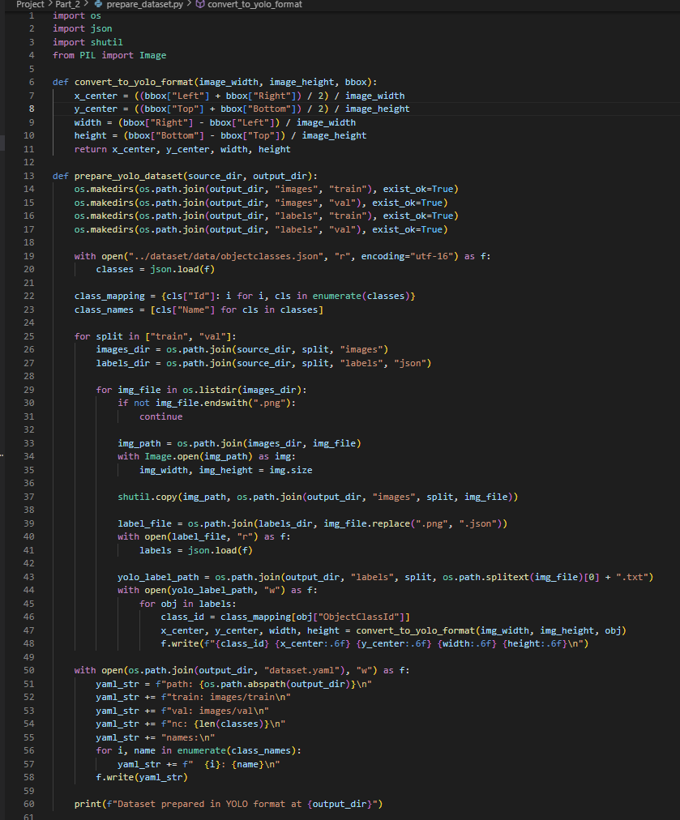
Model Training: Yolo ready Data

Slide 17
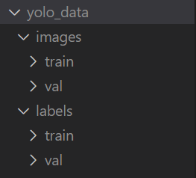
Model Training: Yolo ready Data

Slide 18
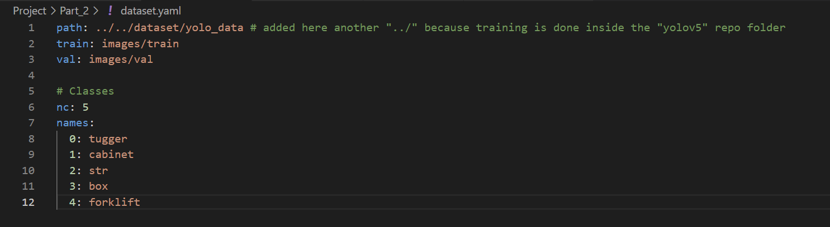
Model Training: YAML file

Slide 19
Model Training: Training Process
Image size: 640×640 pixels
Batch size: 16
Number of epochs: 50
Weights: YOLOv5s pre-trained model

Slide 20
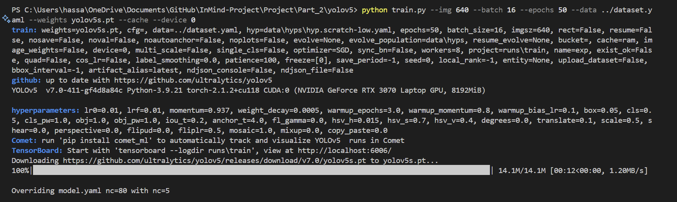
Model Training: Training Process

Slide 21
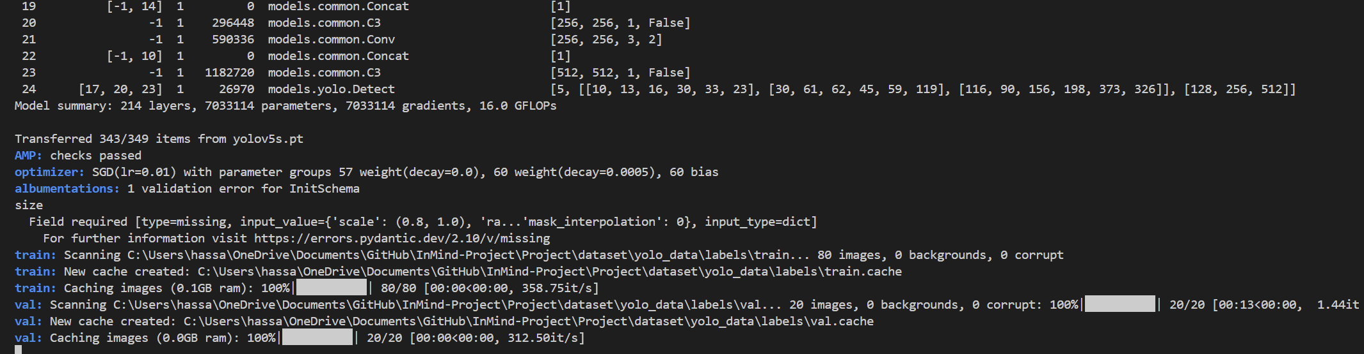
Model Training: Training Process

Slide 22
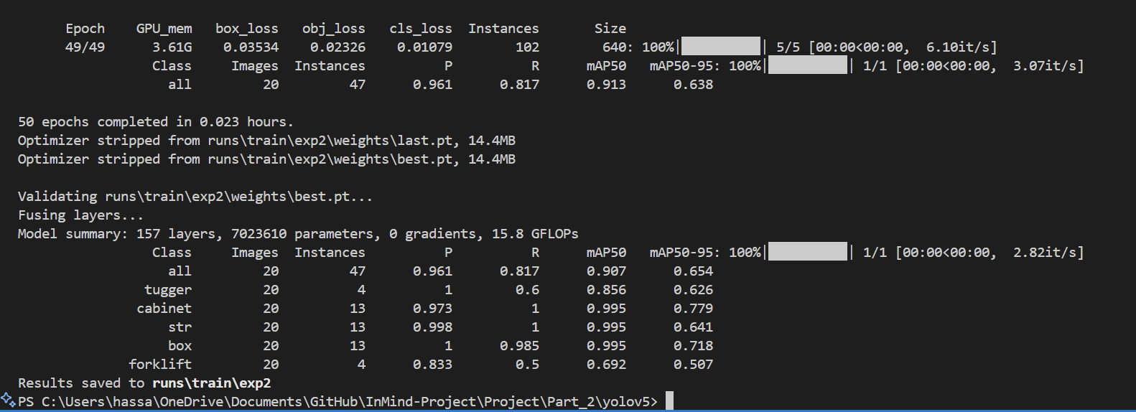
Model Training: Training Process

Slide 23
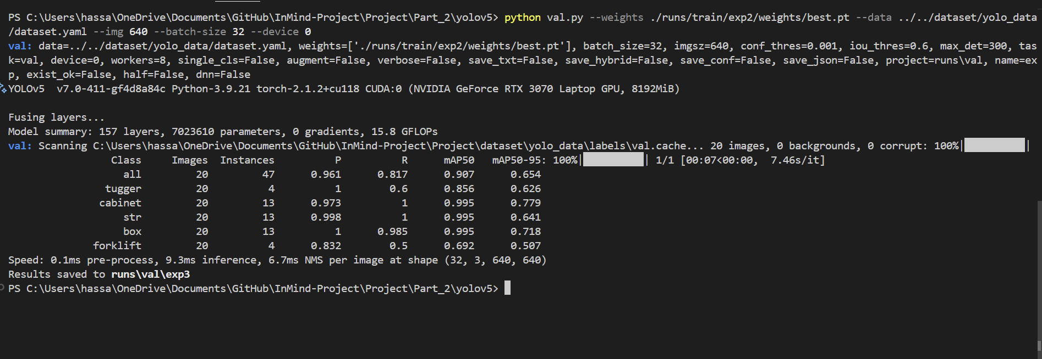
Model Training: Val.py

Slide 24
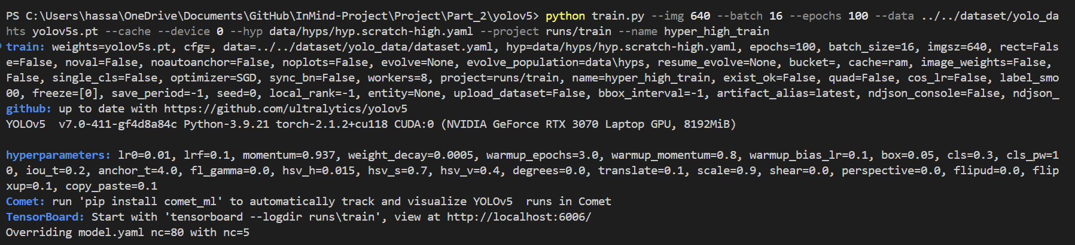
Model Training: Hyper Tuning

Slide 25
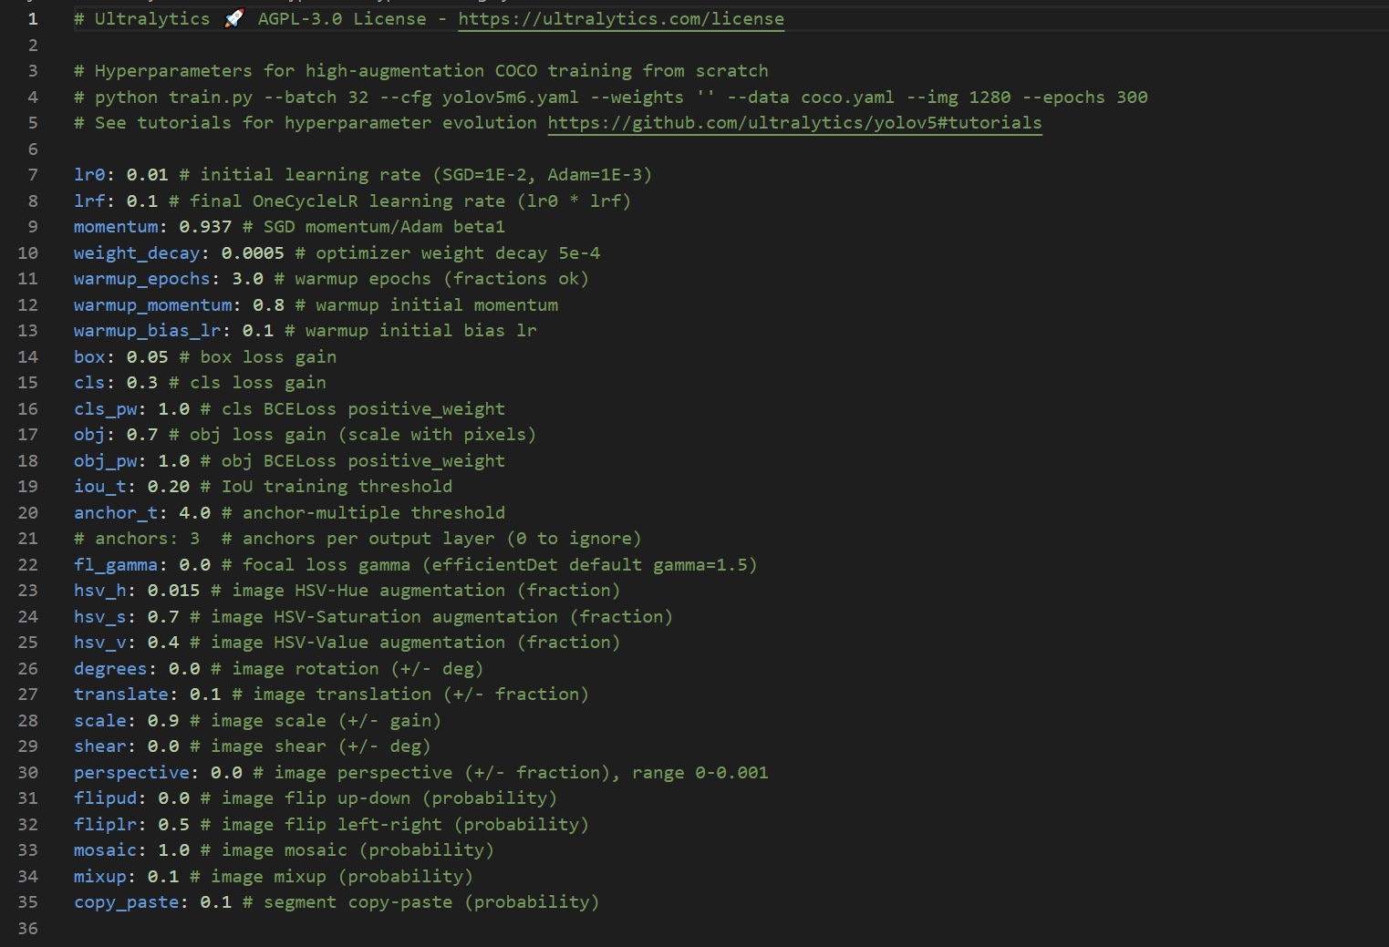
Model Training: Hyper Tuning

Slide 26
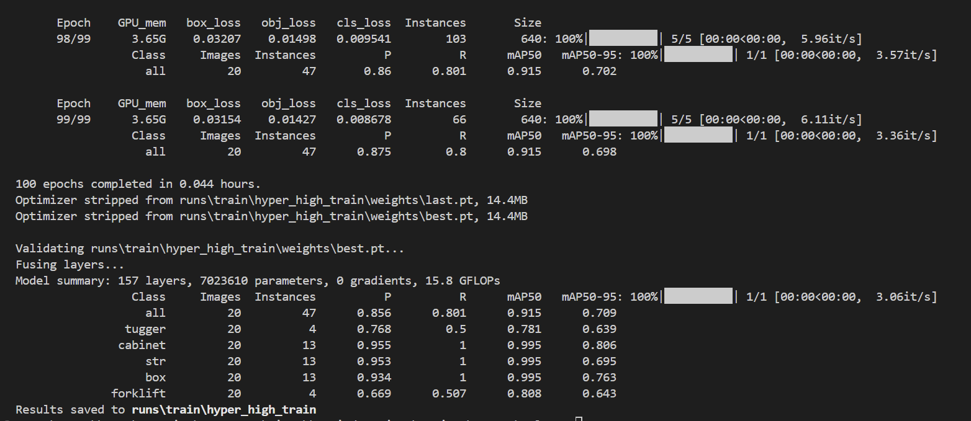
Model Training: Hyper Tuning

Slide 27
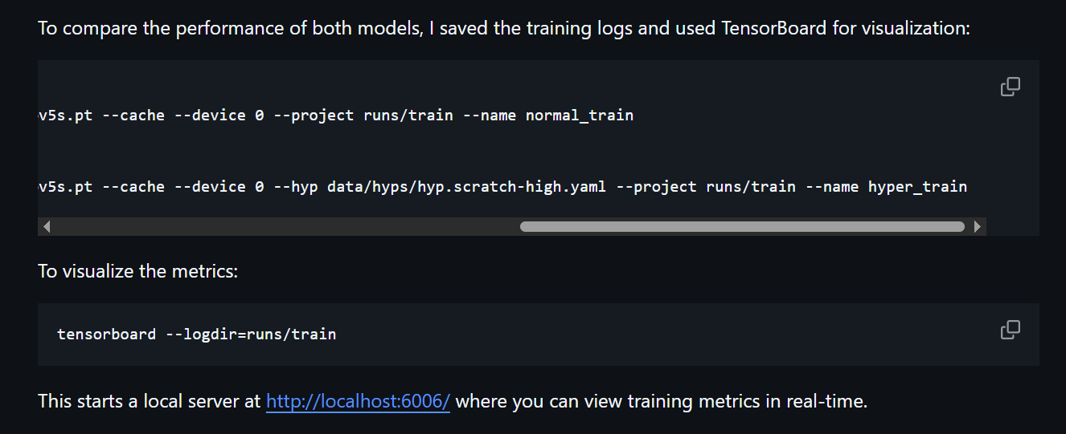
Model Training: TensorBoard

Slide 28
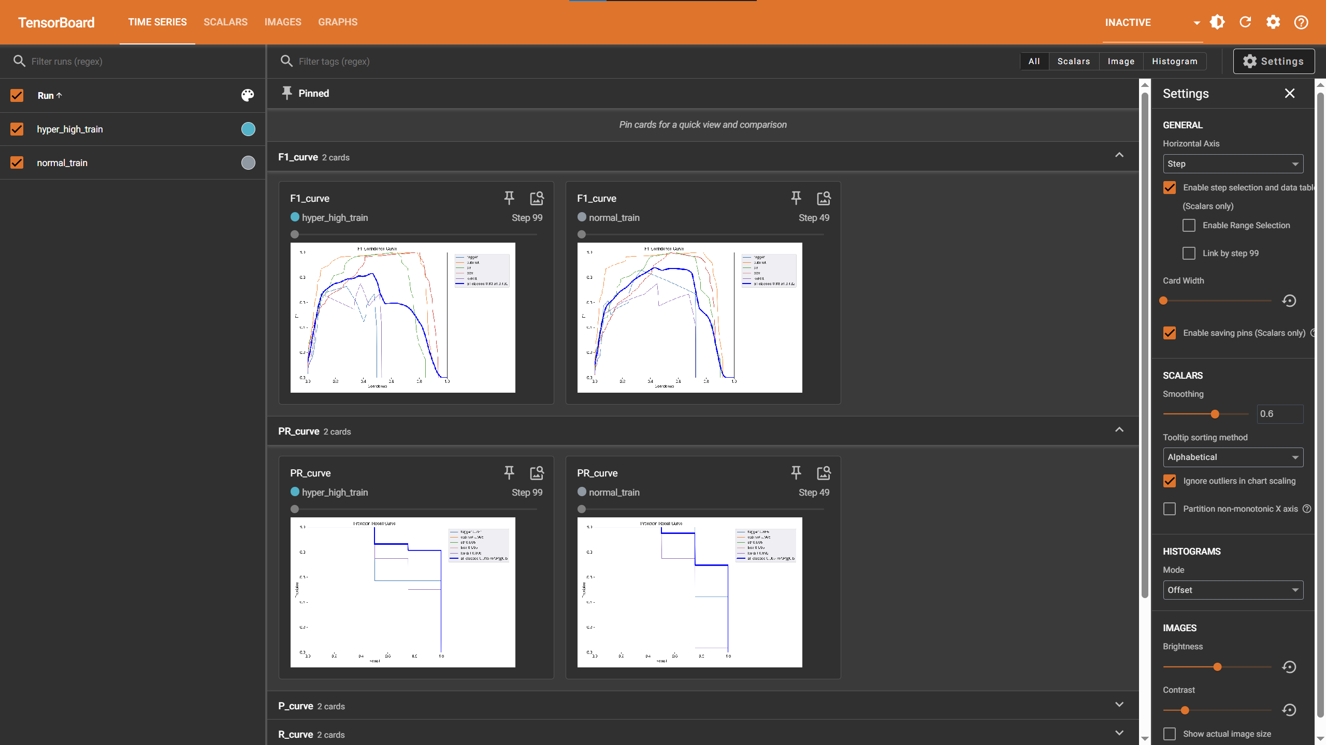
Model Training: TensorBoard

Slide 29
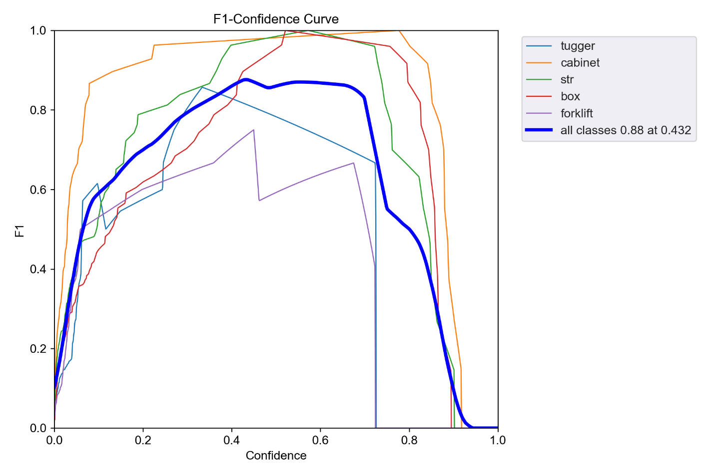
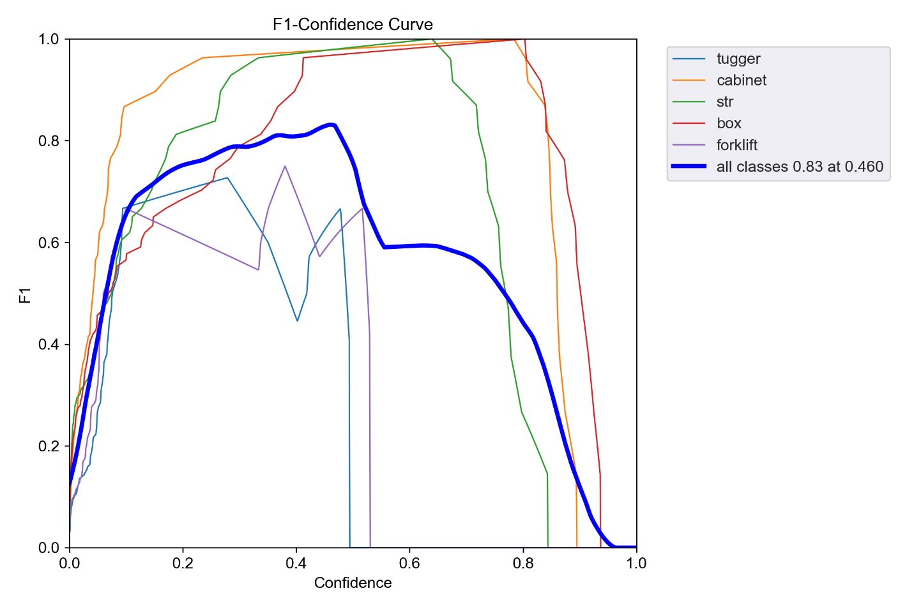
TensorBoard: F1 score curve

Slide 30
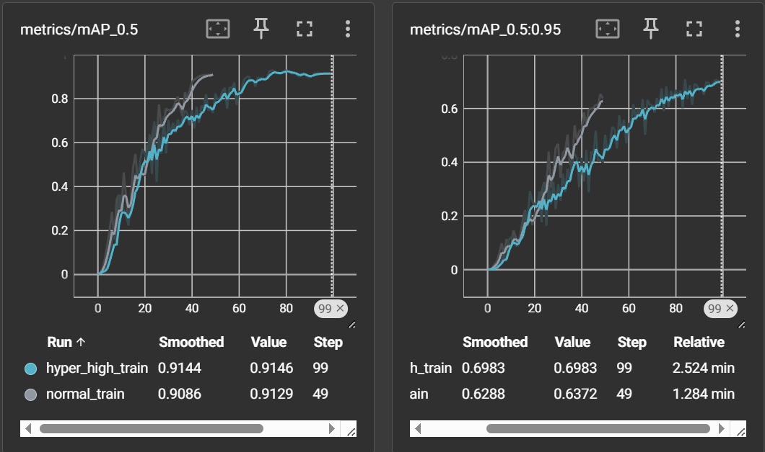
TensorBoard: mAP@0.5:0.95

Slide 31
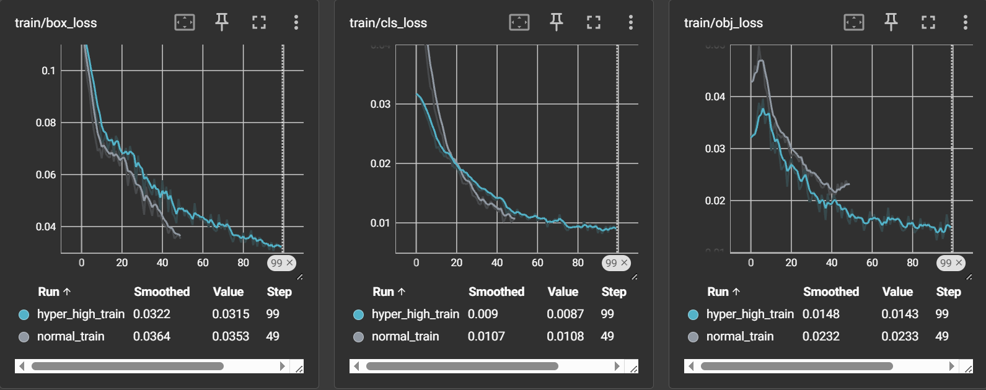
TensorBoard: Train Loss

Slide 32
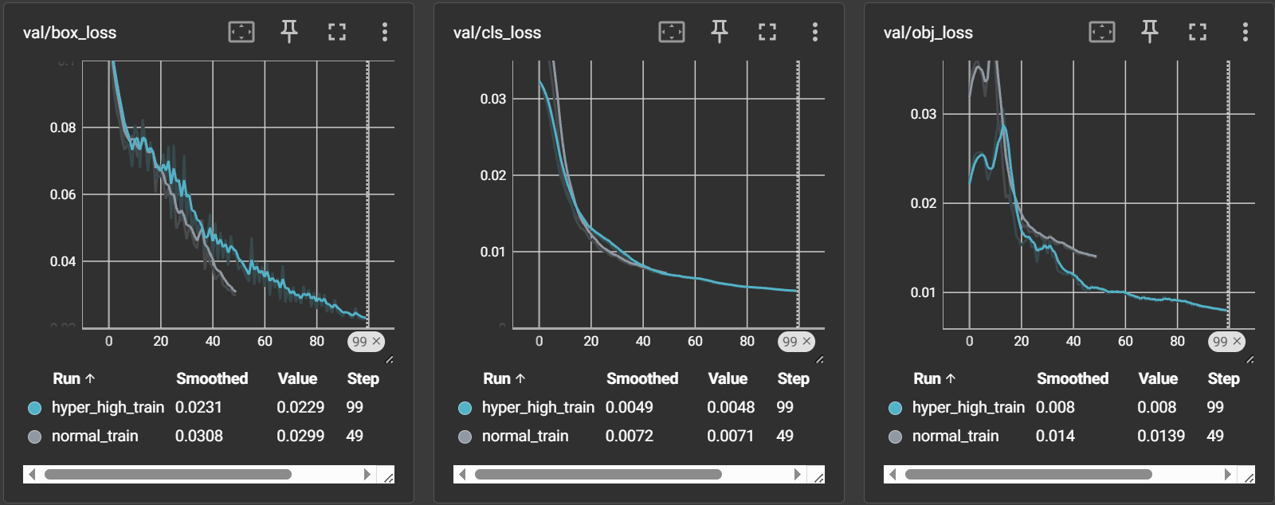
TensorBoard: Val Loss

Slide 33
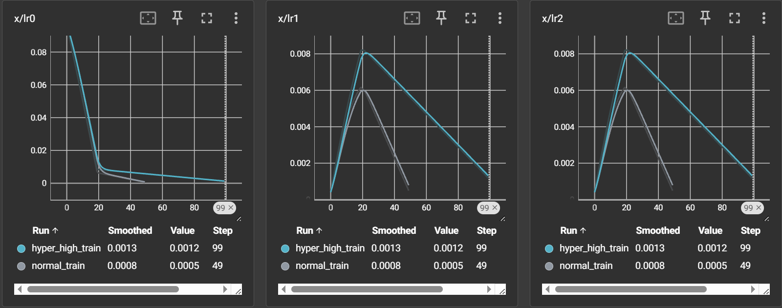
TensorBoard: Learning Rate

Slide 34
TensorBoard: Learning Rate

Slide 35
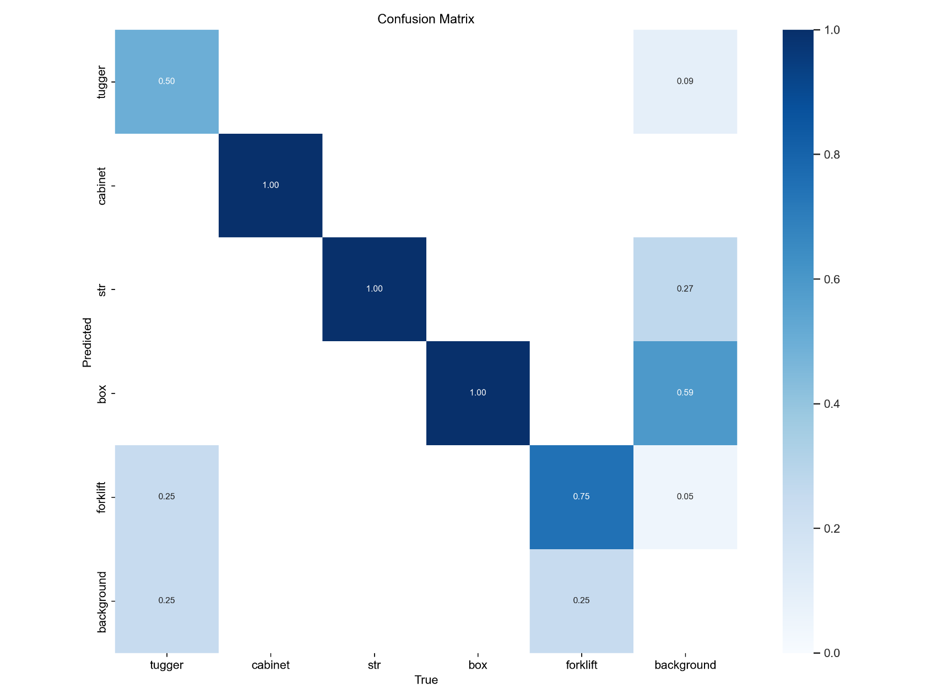
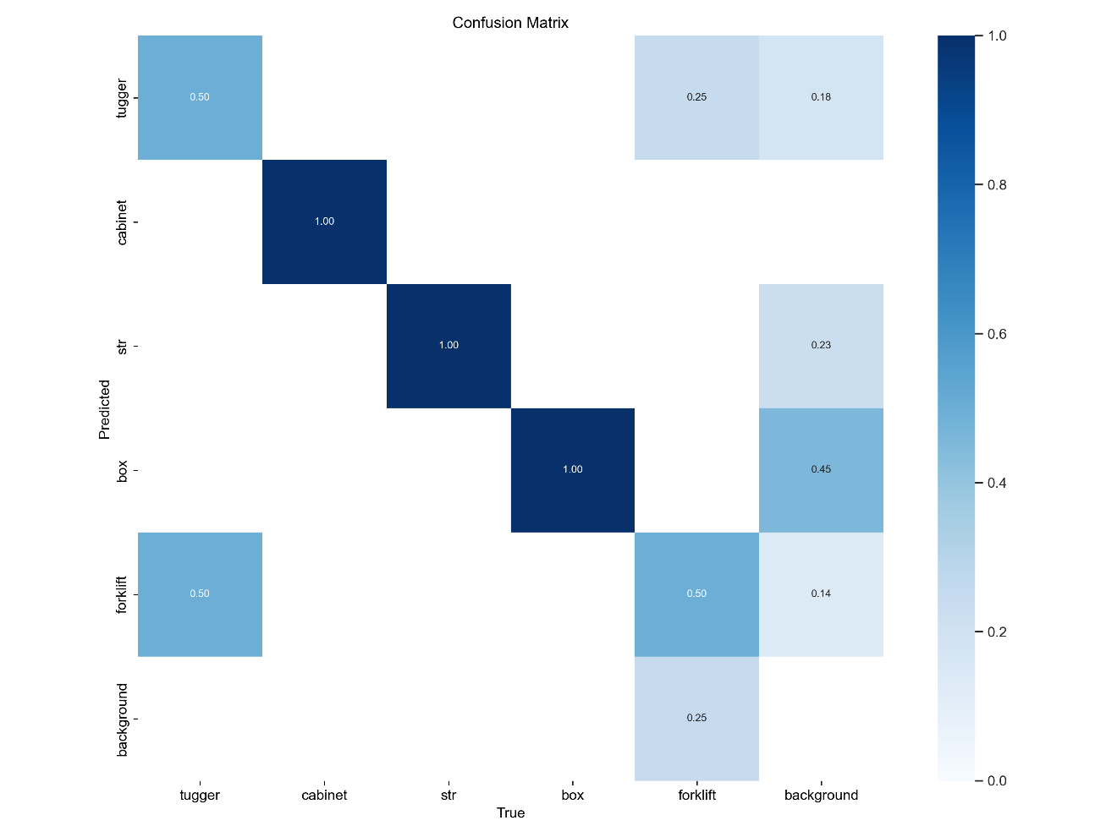
TensorBoard: Confusion Matrix

Slide 36
04
Inference

Slide 37
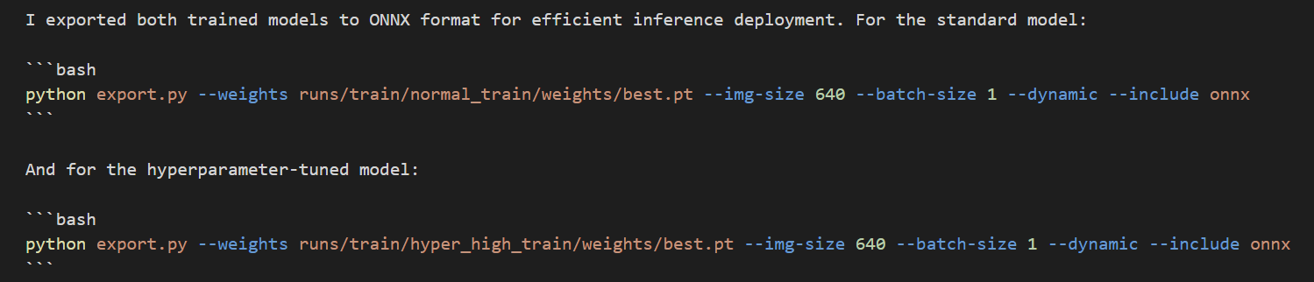
Inference: ONNX

Slide 38
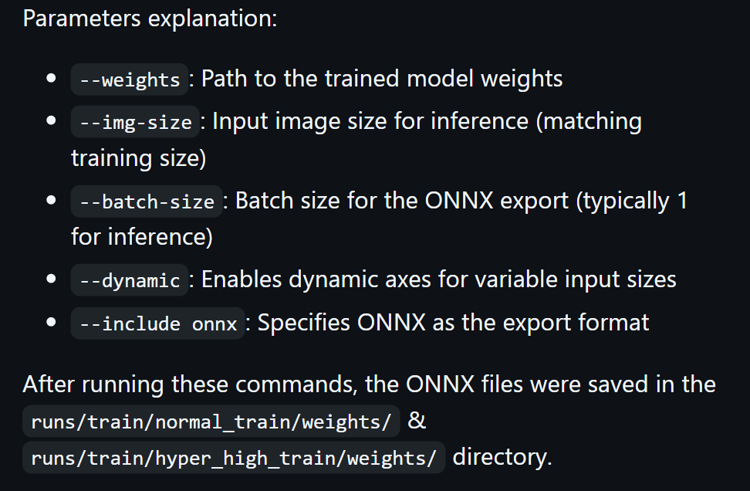
Inference: ONNX

Slide 39
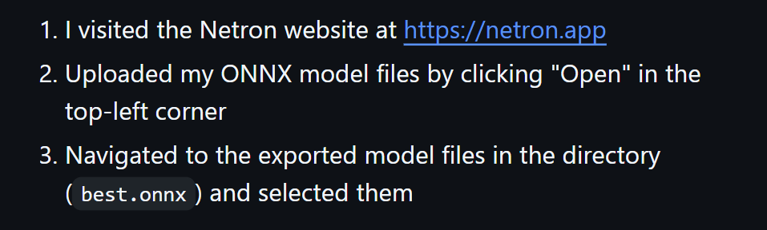
Inference: Netron

Slide 40
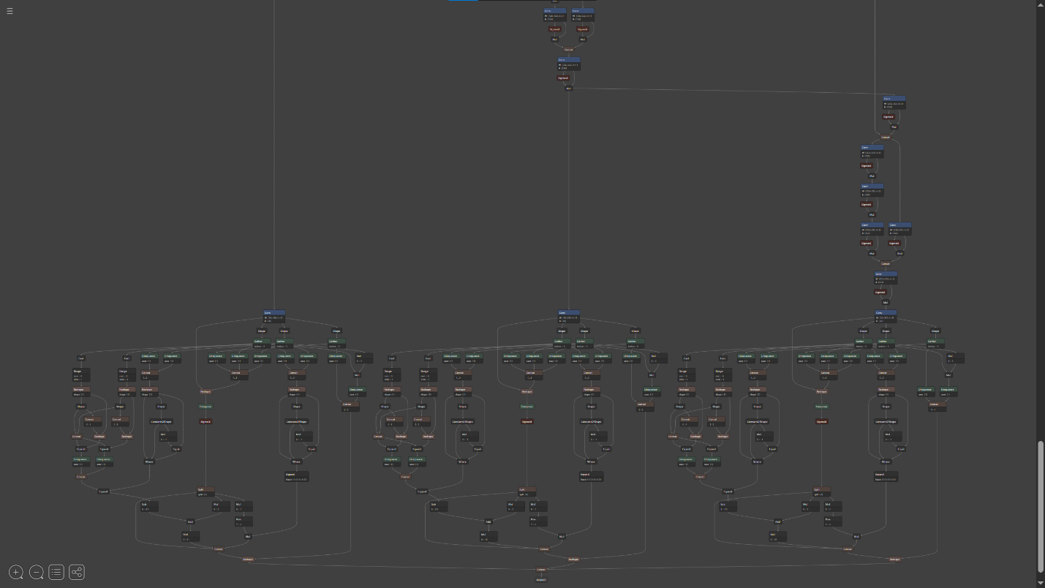
Inference: Netron

Slide 41
Inference: Rest API, FastAPI
The API offers the following endpoints:
GET /: Redirects to the API documentation
GET /models: Lists all available ONNX models
POST /inference: Accepts an image and returns detected objects as JSON
POST /inference_image: Accepts an image and returns the same image with bounding boxes drawn

Slide 42
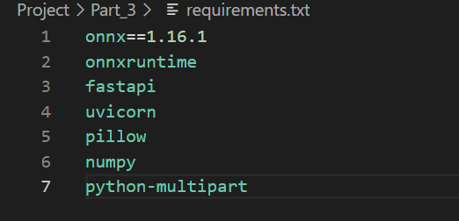
Inference: FastAPI

Slide 43
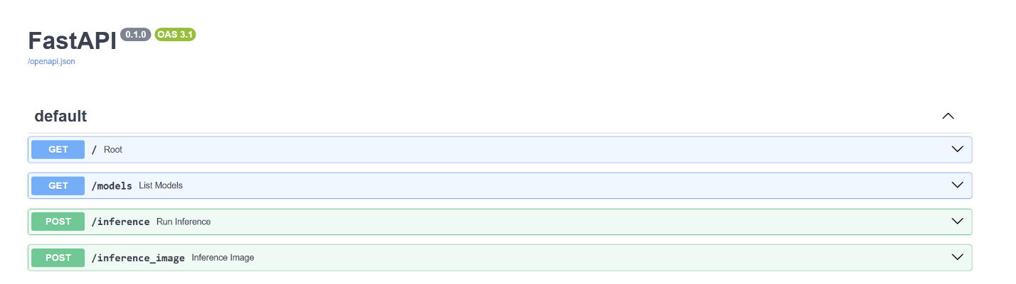
Inference: FastAPI

Slide 44
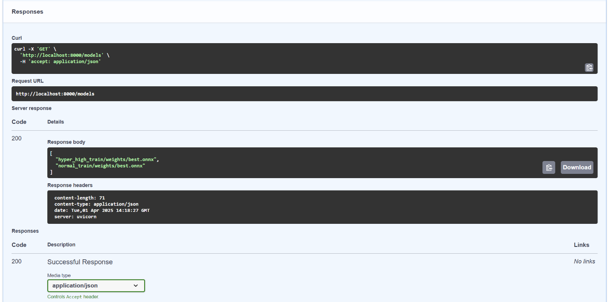
Inference: FastAPI

Slide 45
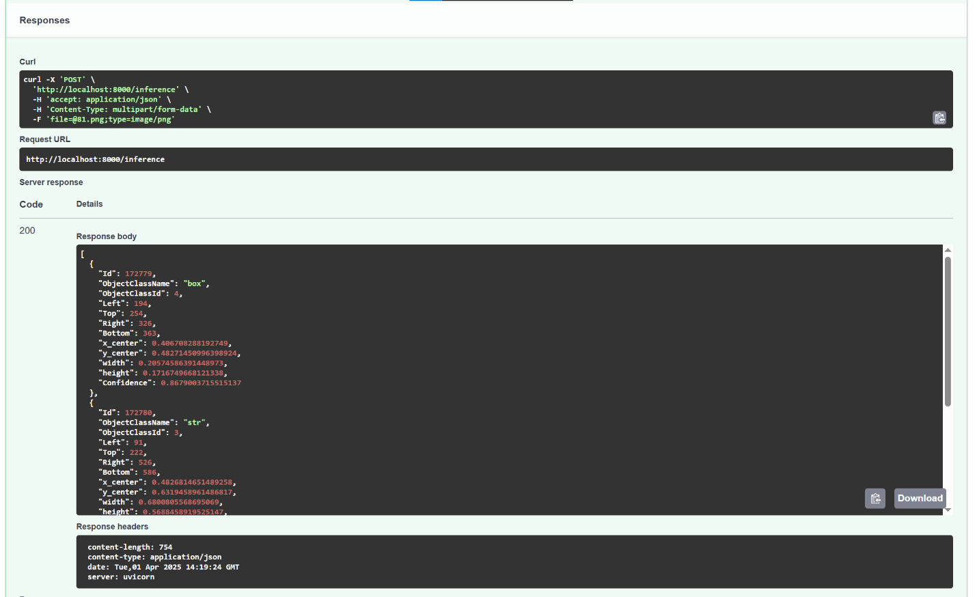
Inference: FastAPI

Slide 46
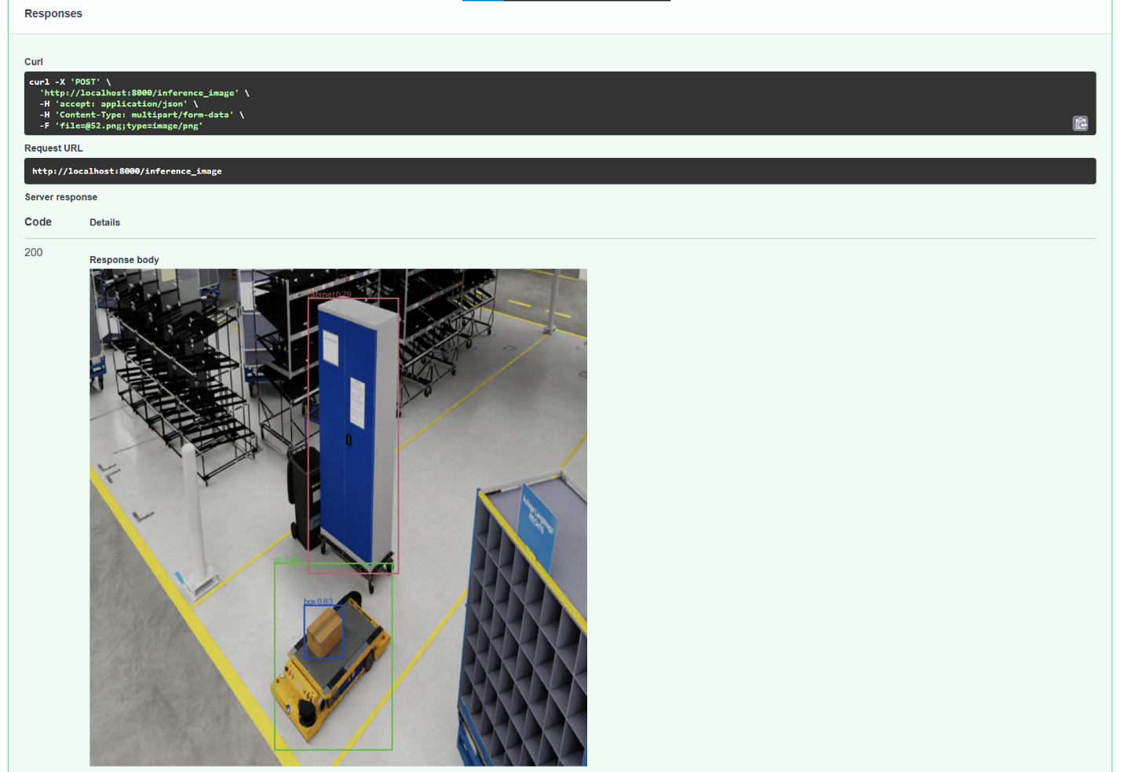
Inference: FastAPI

Slide 47
05
Docker

Slide 48
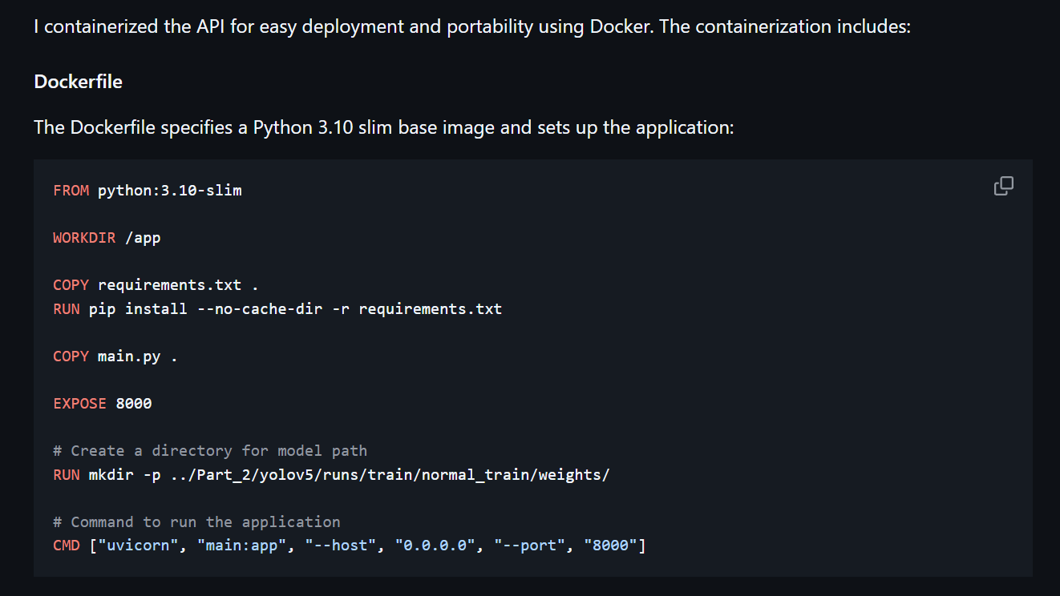
Docker: Dockerfile

Slide 49
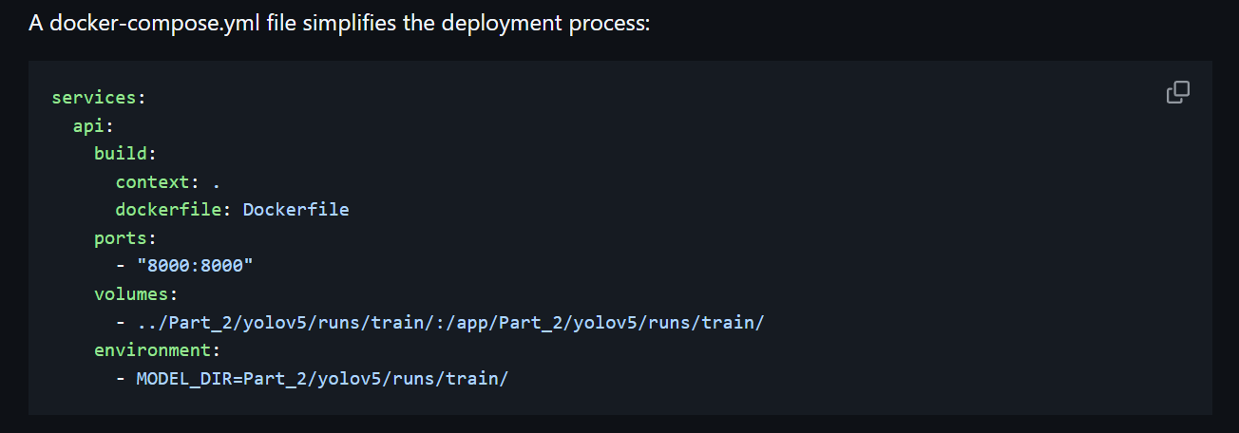
Docker: Compose
This configuration:
Maps port 8000 from the container to the host
Mounts the model directory as a volume
Sets the model directory via environment variable

Slide 50
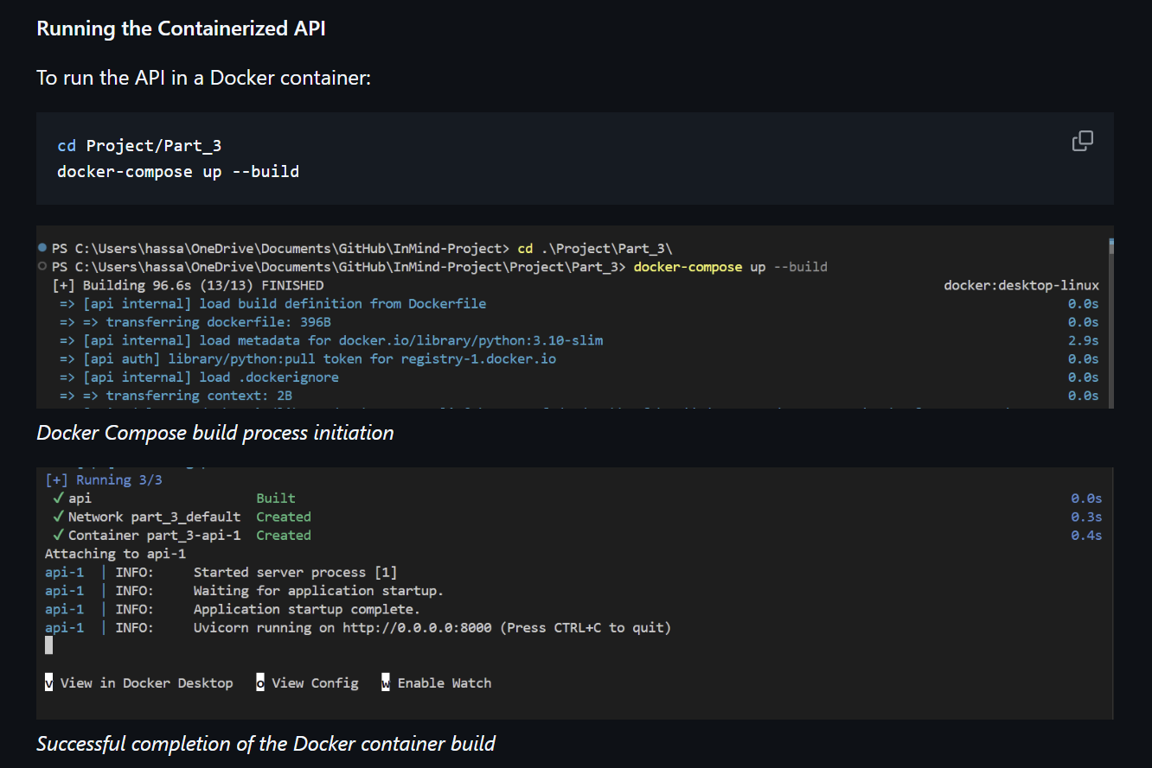
Docker: Build

Slide 51
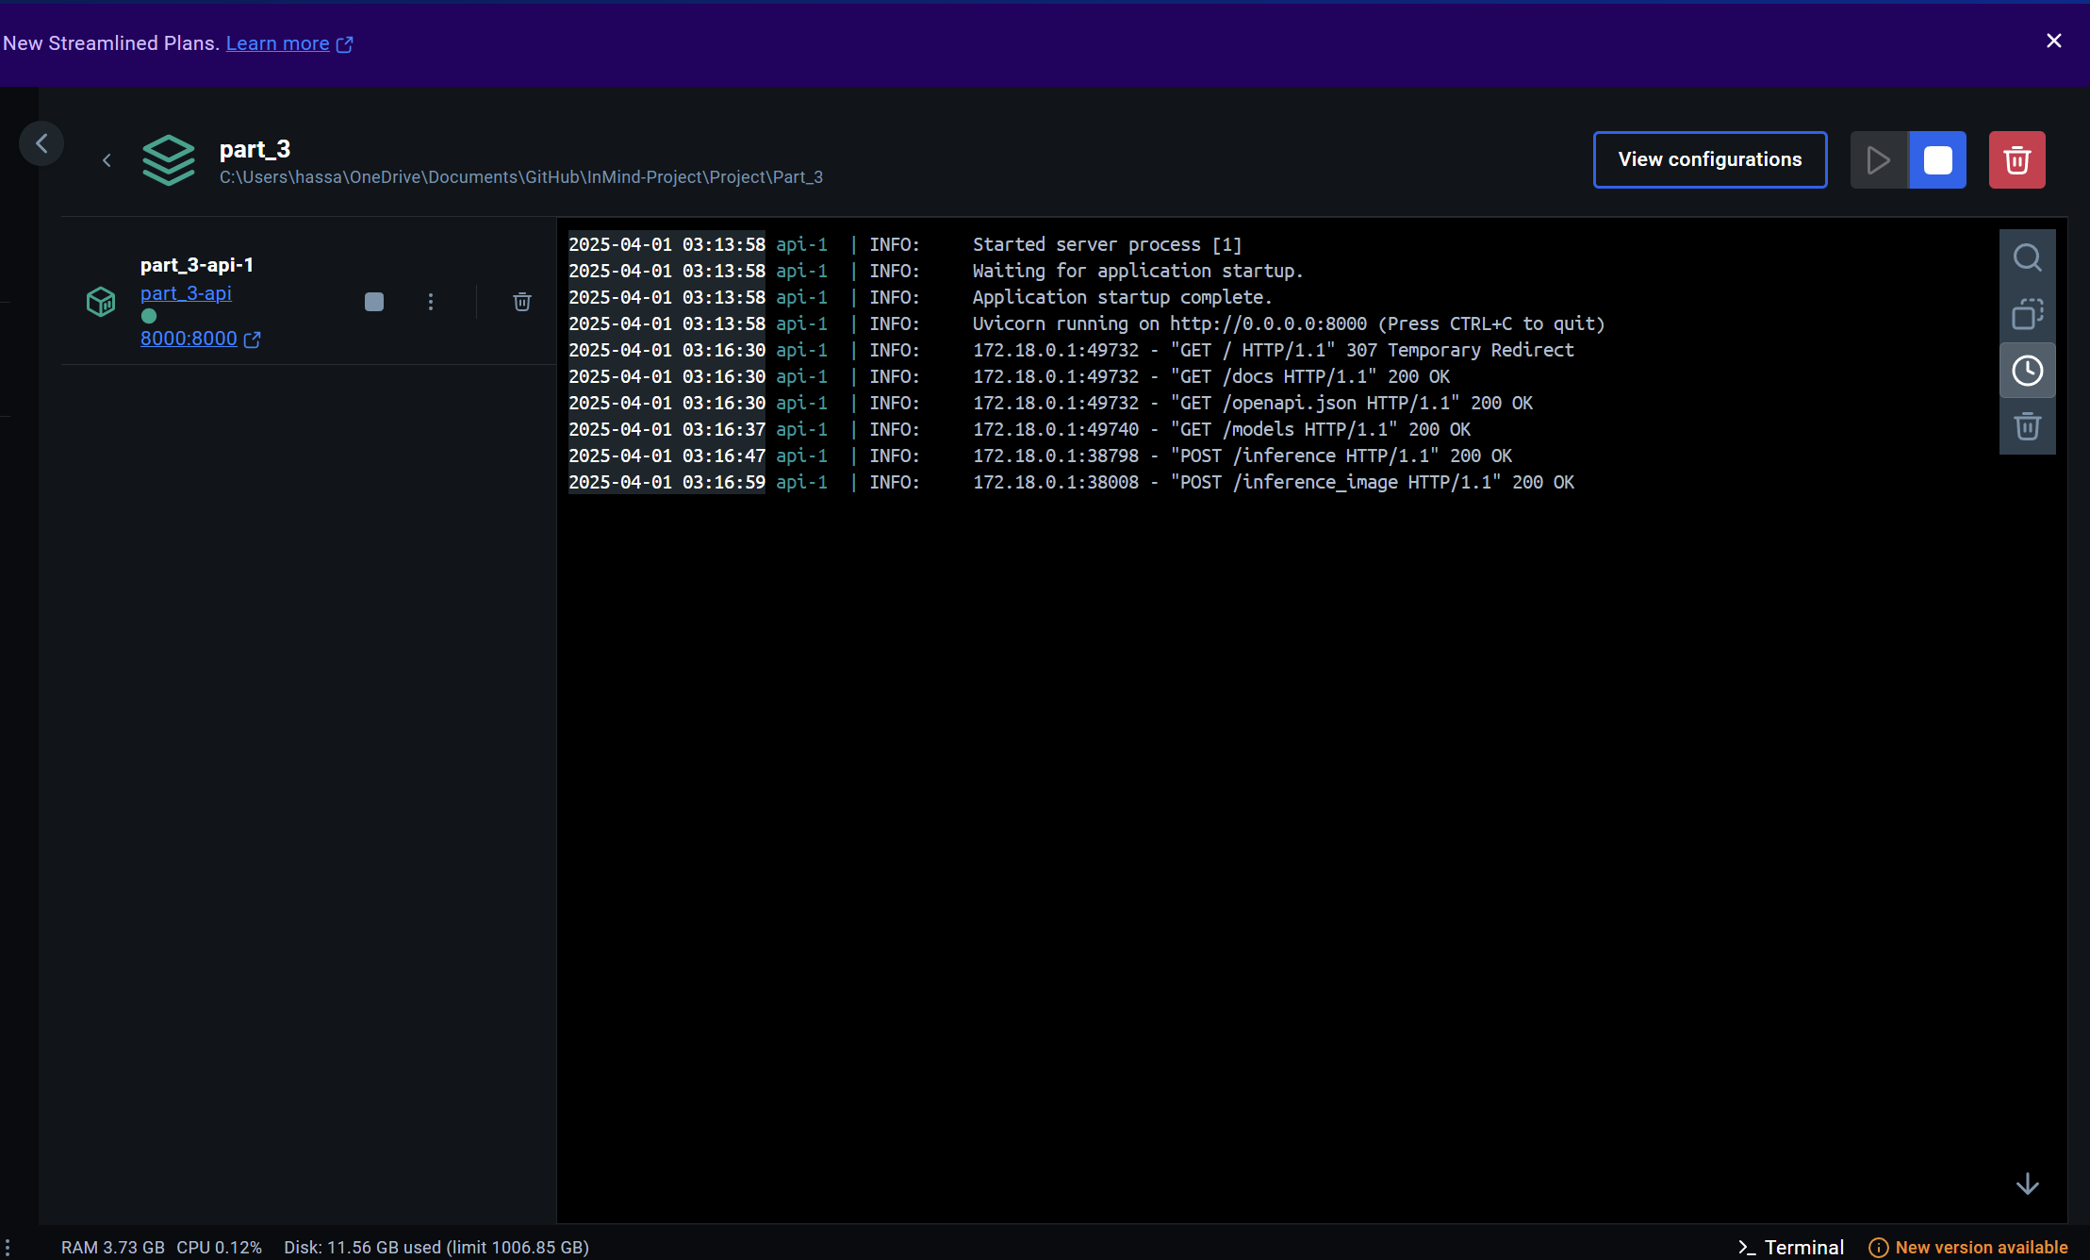
Docker: Desktop App

Slide 52
06
Reference

Slide 53
References
Ultralytics YOLOv5. (2022). GitHub repository. https://github.com/ultralytics/yolov5
ONNX Runtime. (2022). GitHub repository. https://github.com/microsoft/onnxruntime
FastAPI. (2022). Documentation. https://fastapi.tiangolo.com/
Albumentations. (2022). Documentation. https://albumentations.ai/docs/

Slide 54
Thanks!
Do you have any questions?

